Slide 1
Demographics and Restaurant Preferences
Team “Divas and the Brain”
Reyna, Shetu, and Brian

Slide 2
STARTING dataset
US Census Bureau race data for each zip code
US Census Bureau income data by zip code
Over 30,000 zip codes
Initial Challenges:
Zip codes are stored as different types in each database (string vs integer)
Zip codes in Puerto Rico
Zip codes with zero or very low population count
Filtered data: ~10,000 U.S. zip codes

Slide 4

Gathering additional data
Yelp Fusion API
Limited to 5,000 API calls per day
Limited to 50 results per page
Sliced data into 5 random samples of 250 records
Nested “for” loops to query Yelp for each zip code
Gather data by type: Mexican, Chinese, Fast Food

Slide 5
Hypothesis
Correlation between demographics and restaurant preferences
Chose 3 target restaurant types:
Mexican (correlation with Hispanic population)
Chinese (correlation with Asian population)
Fast Food (correlation with income level)

Slide 6
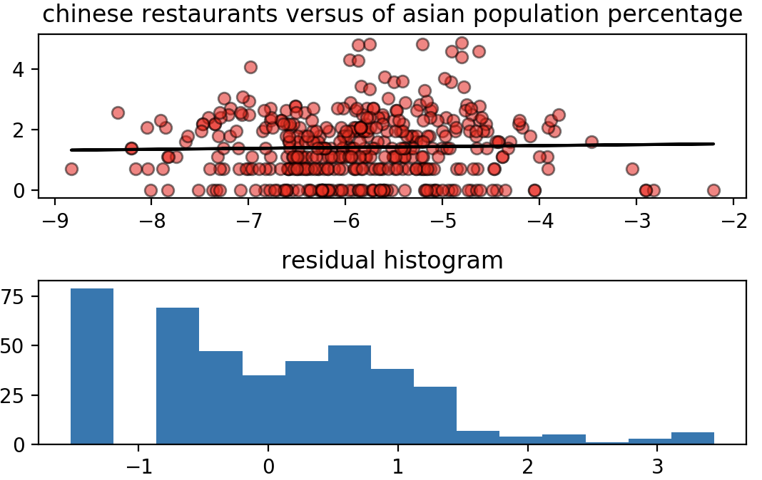
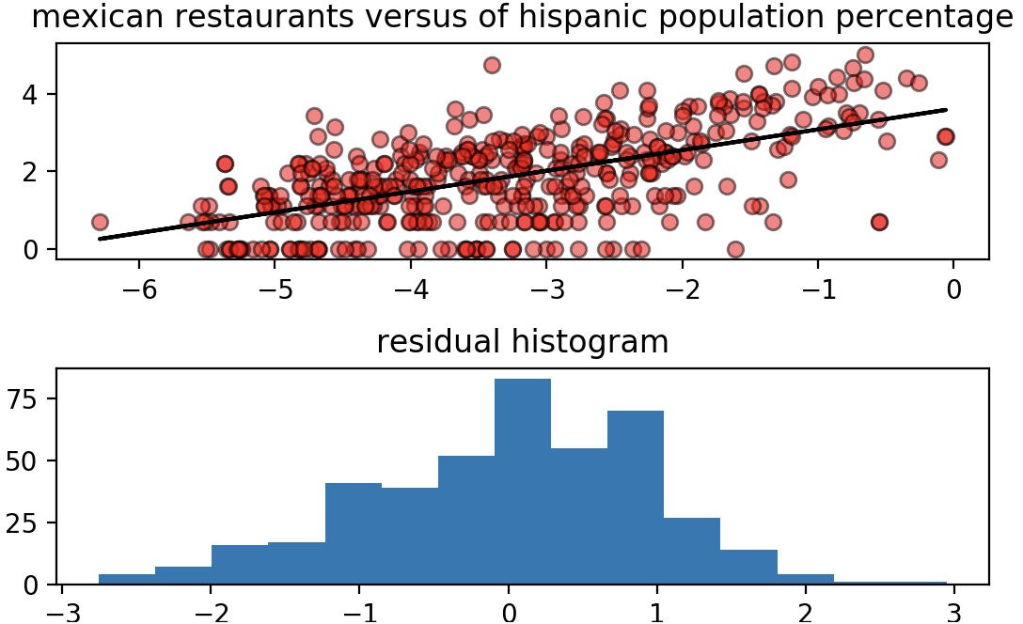
Correlation: Race and Food type
slope: 0.031
r_value: 0.028
p_value: 0.562
slope: 0.534
r_value: 0.590
p_value: 0.000

Slide 7
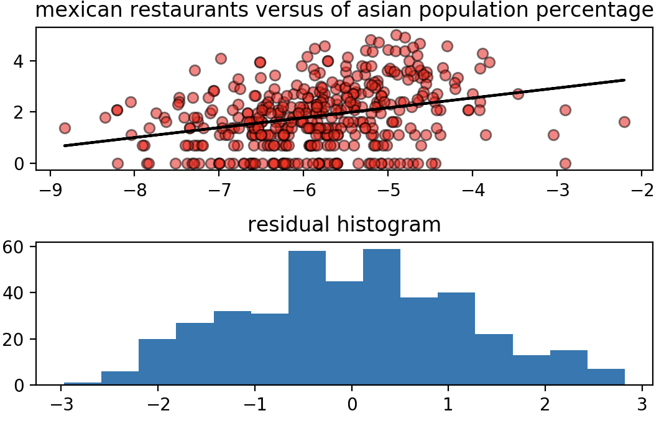
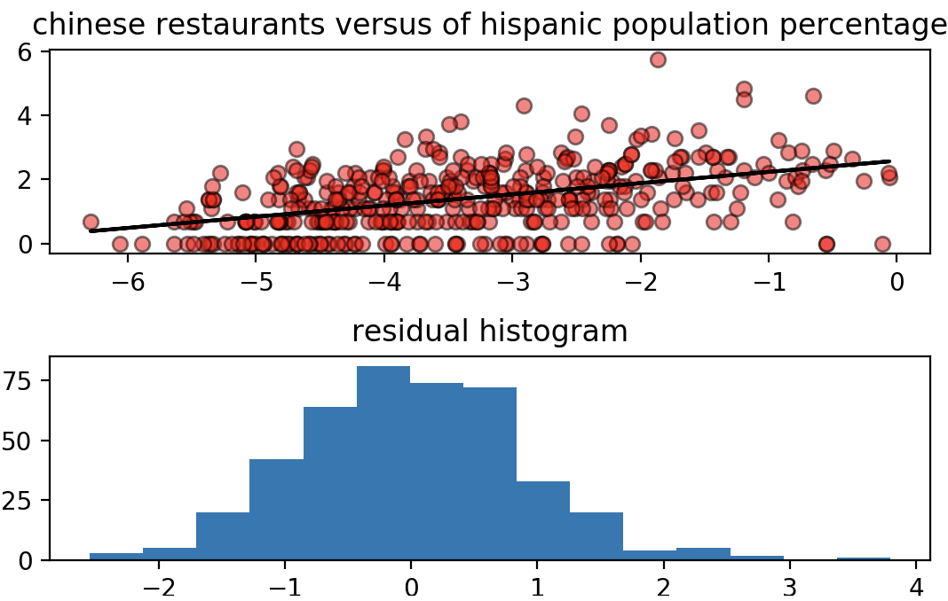
Unexpected results
slope: 0.386
r_value: 0.305
p_value: 0.000
slope: 0.349
r_value: 0.453
p_value: 0.000

Slide 8
Correlation: Income
slope: 0.031
r_value: 0.028
p_value: 0.562
slope: 0.534
r_value: 0.590
p_value: 0.000

Slide 9
Challenges and limitations
Zip codes do not are not consistent:
Different sizes (geographic)
Irregular boundary shapes
Widely varying populations

Slide 10
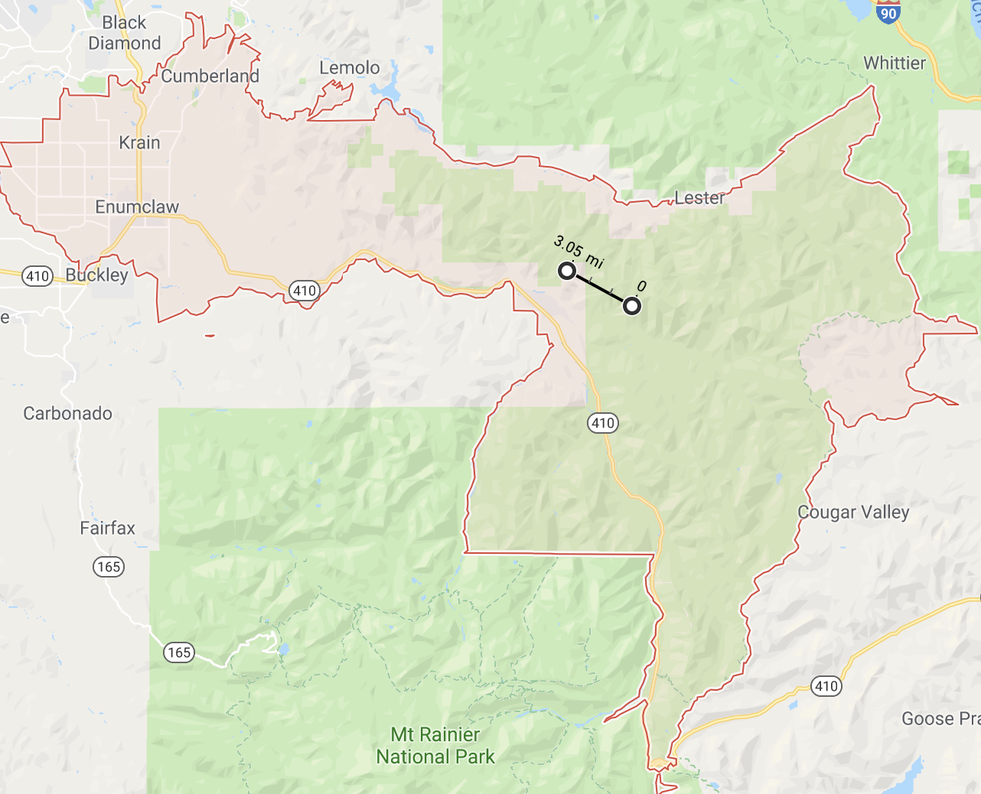
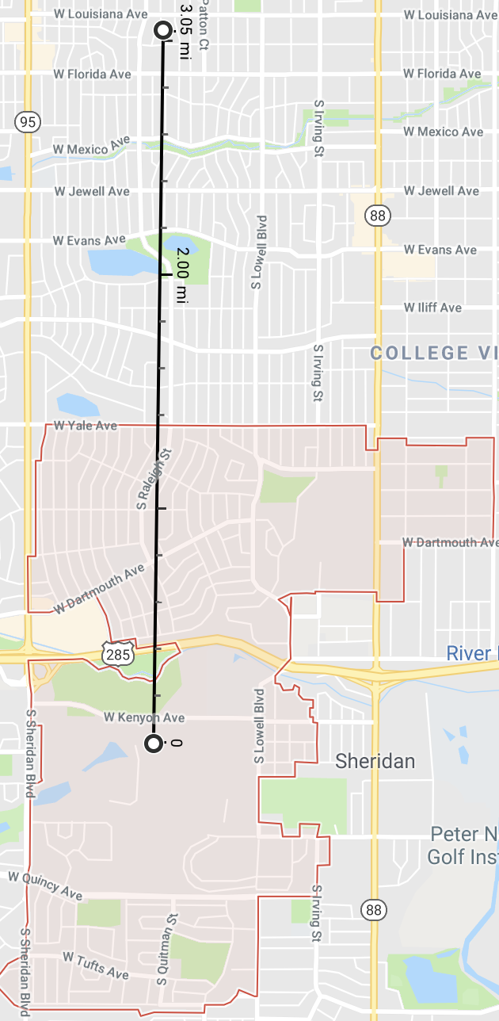

98022 Enumclaw, WA
Total pop: 7,966
Mexican Restaurants: 0
80236 Denver, CO Suburbs
Total pop: 5,917
Mexican Restaurants: 7

